Slide 1
Grid Theory
Riyam k.Marjan
University Of Babylon – Faculty of Information Technology
Third Stage – 2019-2020

Slide 2

Grid Theory
The concept of dividing the elements of a composition extends back to the mathematical ideas established by Pythagoras and his followers, who defined numbers as ratios rather than single units.
Many art historians credit Dutch painter Piet Mondrian as the father of graphic design for his sophisticated use of grids.

Slide 3
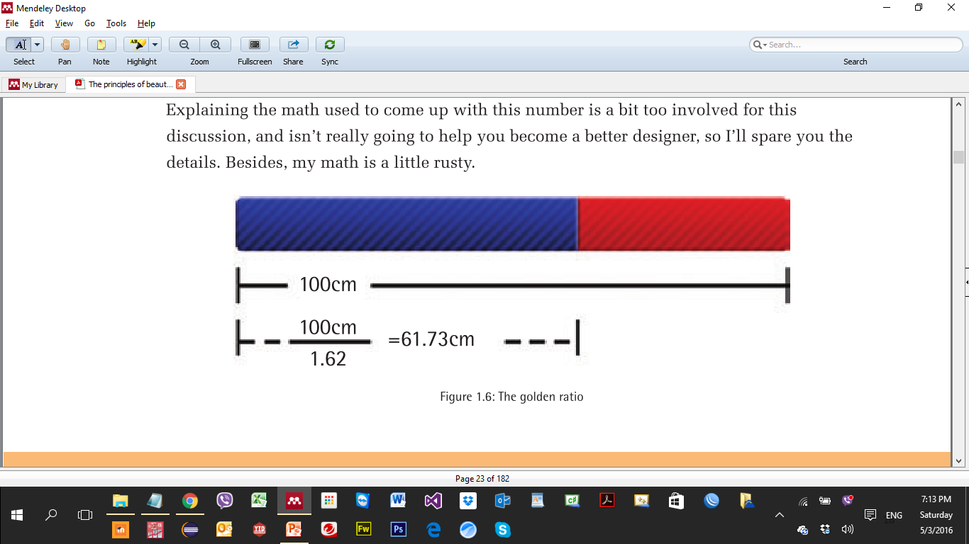
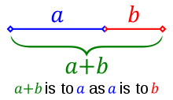
Grid Theory: Golden ratio
A line can be cut by dividing its length by 1.62. This wizardly number 1.62 is in reality 1.6180339 which is quite irrational and represented as symbol (Φ), Or “Phi”.

Slide 4
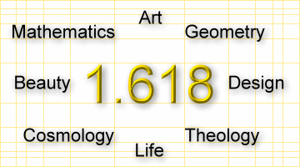
Grid Theory: Golden ratio

Slide 5
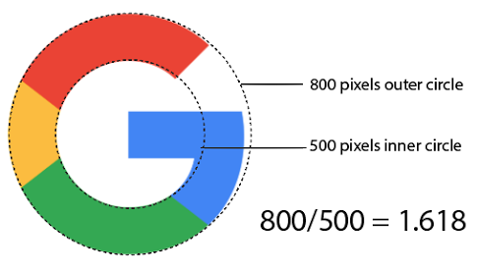
Grid Theory: Golden ratio

Slide 6
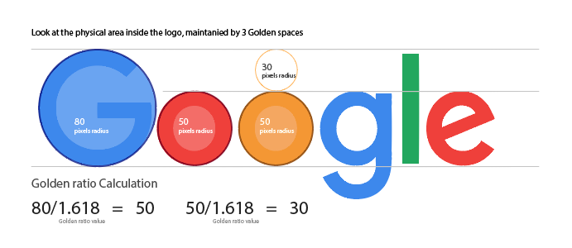
Grid Theory: Golden ratio

Slide 7
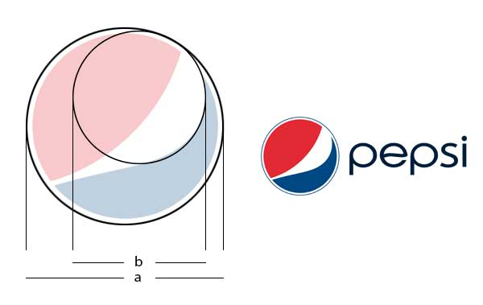
Grid Theory: Golden ratio

Slide 8
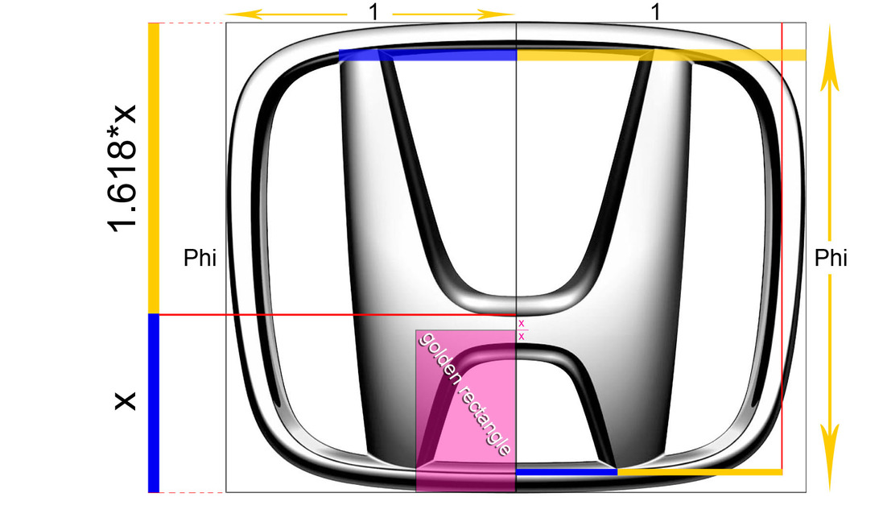

Grid Theory: Golden ratio

Slide 9
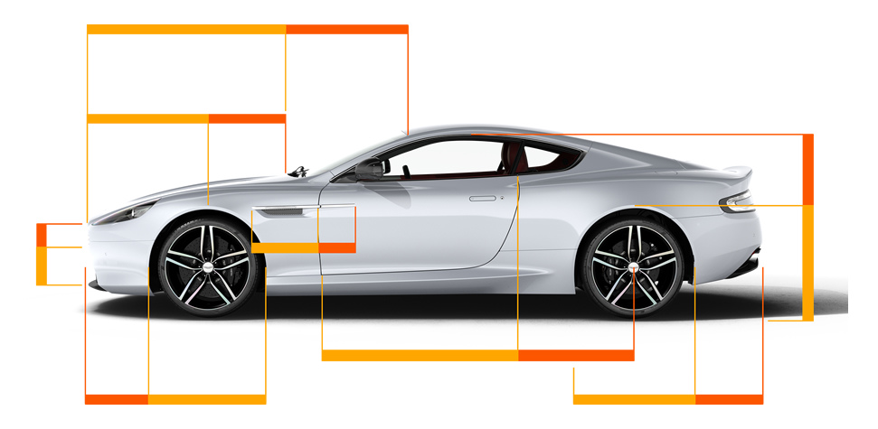
Grid Theory: Golden ratio

Slide 10
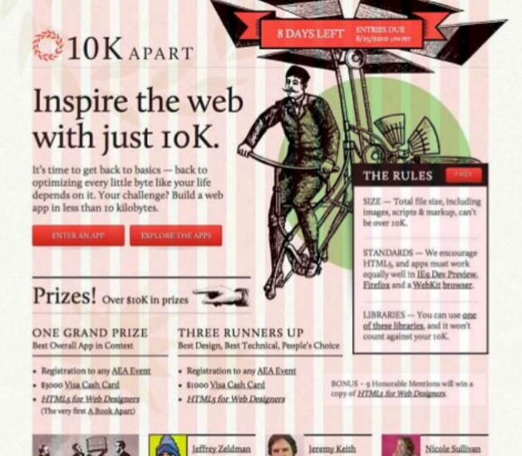
Grid Theory: 960 grid systems
derived from 960 px which found to be the typical web page width for a screen resolution of 1024 px wide.

Slide 11
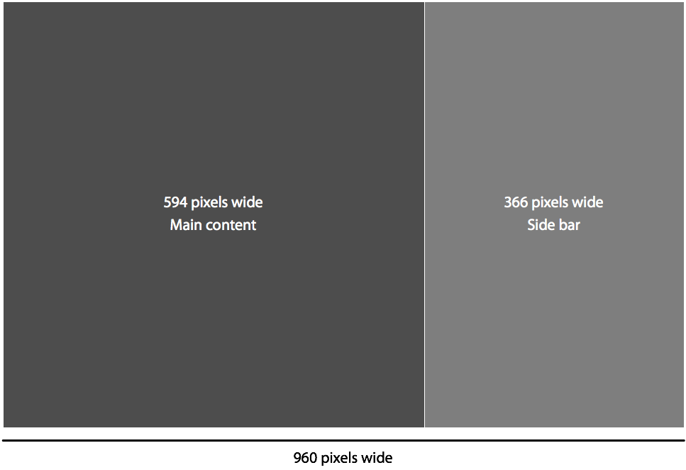
Grid Theory: 960 grid systems
take your typical 960 pixel width layout and divide 960 by 1.618. You’ll get about 594, which is the width of your main content column. To get the width of your side bar, subtract 594 from 960 and you get 366. Put it all together and you have a two column layout with widths of the golden ratio.

Slide 12
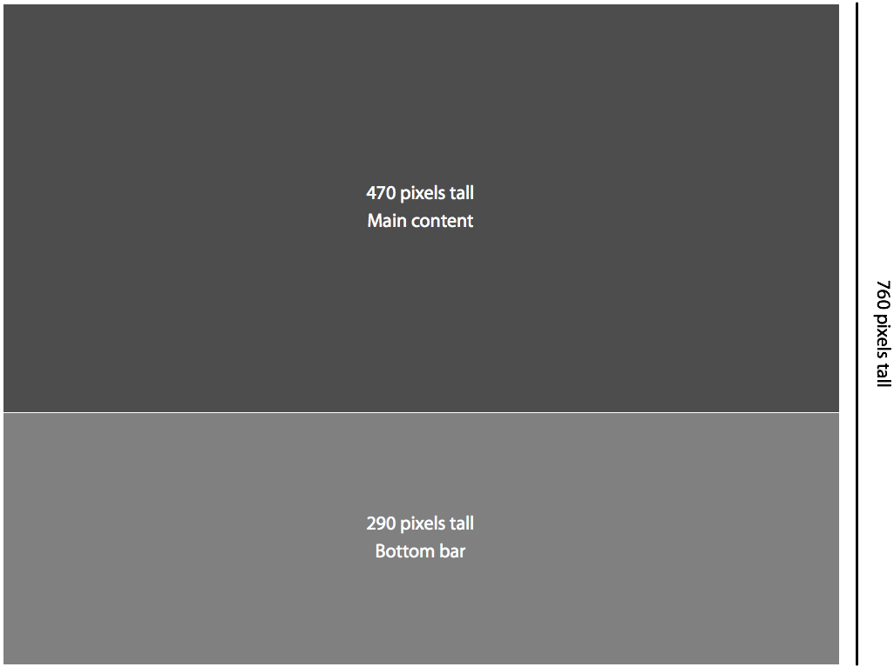
Grid Theory: 960 grid systems
you can also apply the golden ratio to the height of your website, assuming your page has a fixed height. For example, take the height of 760 pixels and divide that by 1.618, and you get about 470 pixels, which is the height of your main content area. Take 470 away from 760 and you end up with 290 pixels, which is the height of your bottom bar.

Slide 13
Grid Theory: The role of third
according to the rule of thirds, the vertices of those lines (where the lines cross) are the ideal placement for points of interest. People scanning the page are more likely to notice things placed near the points, and the division is comfortable to view. More complex design is possible by breaking down those thirds into further thirds.

Slide 14
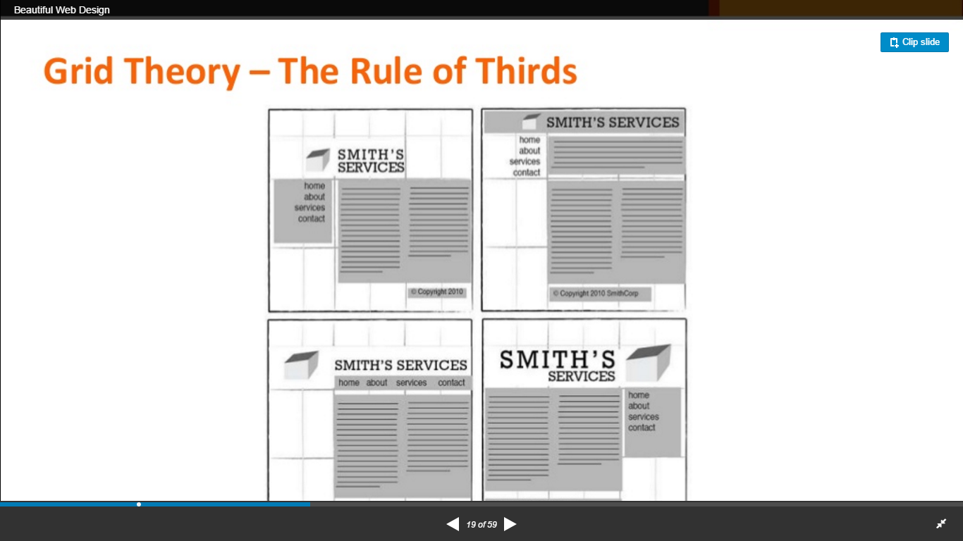
Grid Theory: The role of third

Slide 15
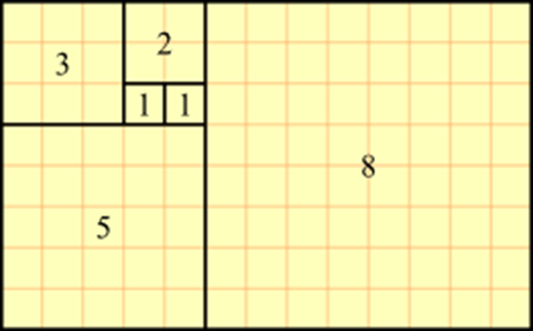
Grid Theory: Fibonacci Sequences

Slide 16
Grid Theory: Fibonacci Sequences
The spirals have been used in artwork for as long as the numbers and ratios themselves. The theory is that areas of negative space and visual interested should fit within the spiral. Within this graceful layout, as with the rule of thirds, the eye is naturally drawn to the centre of the spiral to look for details.

Slide 17

Grid Theory: Fibonacci Sequences

Slide 18
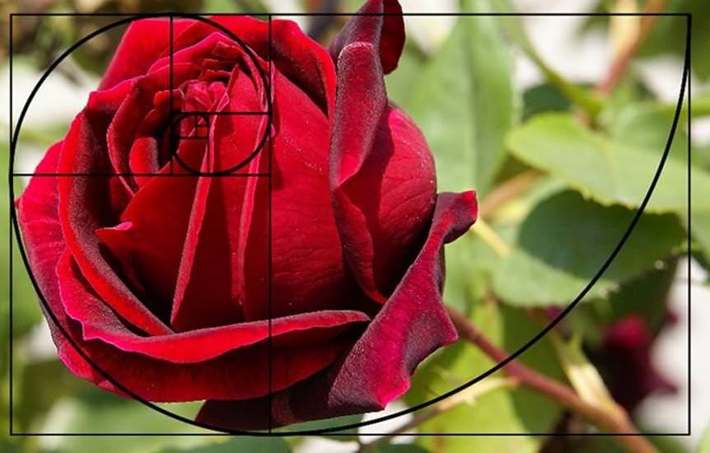
Grid Theory: Fibonacci Sequences

Slide 19
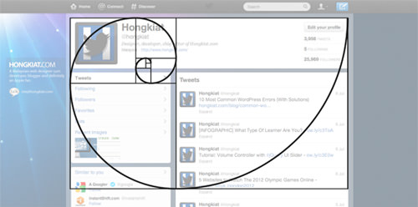
Grid Theory: Fibonacci Sequences

Slide 20
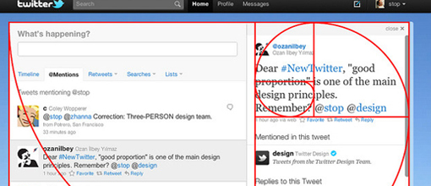
Grid Theory: Fibonacci Sequences

Slide 21
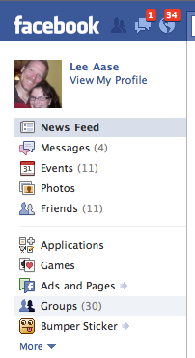
Layout models: left-column navigation
Considerations are:
1- for some reasons, a layout featuring left- column navigation is a safe choice for any project.
2-the downside to sites that use left-column navigation is that they can lack creativity. They’ve been done so many times, and in so many ways, that they tend to look the same.

Slide 22
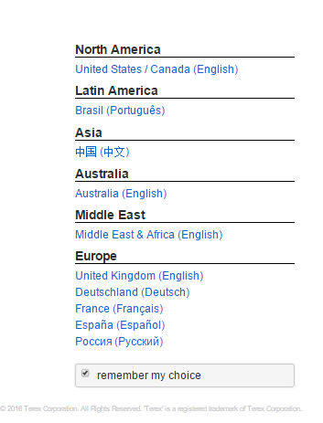
Layout models: right-column navigation
Considerations are:
1- left-column navigation is familiar and more standard, but that’s not always the number one priority in designing a new site.
2- cursor tends to hover on the right side of the browser window anyway—so you can be closer to the scrollbar.

Slide 23
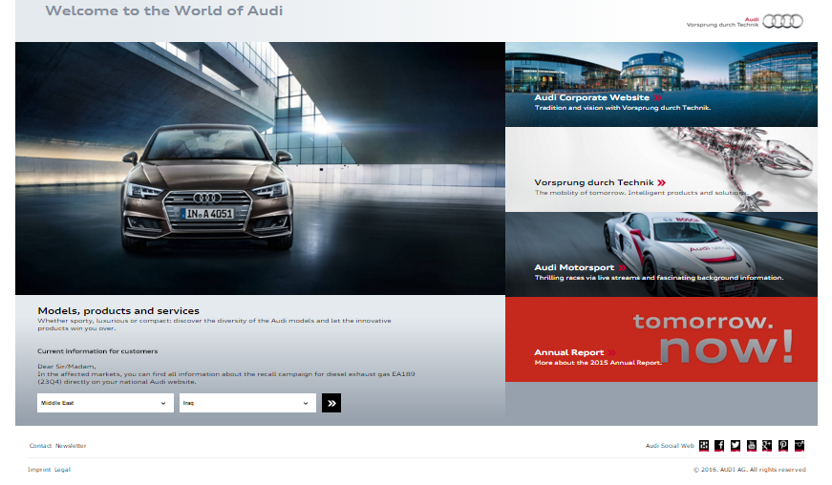
Layout models: right-column navigation

Slide 24

Layout models: three-column navigation
Considerations are:
1- necessary on pages that
have several navigations, short bits of content, or advertising to display
2- it’s important to remember that whitespace is essential to promote eye movement.

Slide 25
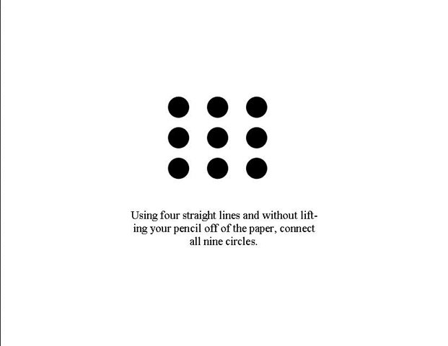

Layout models: outside the box

Slide 26
Layout models: outside the box
CSS Zen Garden at http://www.csszengarden.com/
CSS Beauty at http://www.cssbeauty.com/
CSS Vault at http://cssvault.com/
Design Interact Site of the Week at http://www.designinteract.com/sow/

Slide 27
Thank you

